Slide 1


Campus-Cruise
Revolutionizing Student Commuting
SAFE • AFFORDABLE • COMMUNITY

Slide 2






The Concept: A Dedicated Platform
Student-Centric Solution
Inspiration & Scope
A platform allowing students with vehicles to offer rides while others book available seats seamlessly.
Inspired by global leaders like Uber and Pathao, but tailored for the unique needs of UIU students.
Core Values
Seamless Integration
Prioritizes safety, trust, and affordability within a verified academic environment exclusively for UIU.
Easy registration using official UIU emails with flexible roles as either a Rider or a Driver.

Slide 3






The Motivation: Solving Challenges
Addressing High Costs: Significantly reduces daily transportation expenses through shared commuting.
Safety First: Creates a trusted environment restricted to verified university members only.
Resource Optimization: Utilizes underused personal vehicles to improve overall campus mobility.
Enhanced Experience: Offers a simple, user-friendly interface tailored to student schedules.
Community Building: Promotes cooperation and social interaction among students.

Slide 4







Core Features: Empowering the Journey
APP ECOSYSTEM
User Authentication
Ride Management
Smart Booking
Secure UIU email verification for all participants to ensure a trusted community.
Intuitive posting for drivers and easy searching for riders with real-time updates.
Automated request system with instant status notifications and seat tracking.
Intelligent Matching
Interactive Chat
Trust System
Advanced algorithms to find the best ride options based on route and timing.
Seamless in-app communication for coordination between riders and drivers.
Comprehensive rating and review mechanism to maintain high service quality.

Slide 5






Seamless Access: Authentication
UIU EMAIL VERIFIED
Verified Registration
Exclusive access granted only via official UIU email addresses to ensure a closed, safe community.
I am a Rider
Secure Login
Robust authentication protocols to protect user data and maintain the integrity of the platform.
I am a Driver
Flexible Role Selection
Simple Onboarding
Quick profile setup process designed to get students moving safely in just a few steps.

Slide 6



For Drivers: Effortless Ride Posting
Route Specification
Schedule Control
Enter pickup points and destinations with smart suggestions.
Choose dates and times that fit your class schedule.
Seat Management
Ride Visibility
Driver Dashboard
Manage available seats in real time to avoid overbooking.
Posted rides become searchable for students on the same route.
DRIVER MODE ACTIVE

Slide 7




For Riders: Smart Search & Booking
Location-Based Search
Detailed Listings
Find rides starting from or heading to specific campus landmarks and nearby student hubs.
View driver ratings, vehicle details, and available seats before making a commitment.
Time Filtering
Instant Requests
Narrow down options based on class schedules, ensuring you never miss a lecture.
Send booking requests directly to drivers with a single tap for immediate confirmation.
FIND YOUR RIDE NOW

Slide 8





Coordination: Matching and Chat
SMART MATCHING
REAL-TIME SYNC
Route Matching
In-App Chat
Advanced logic to suggest rides that align with the user's path to or from campus.
Direct messaging to coordinate pickup spots and handle last-minute changes securely.
Time Alignment
Status Tracking
Ensures pickup and drop-off times work for both parties, syncing with class schedules.
Real-time updates on booking acceptance, driver arrival, and ride progress.

Slide 9




Quality Control: Ratings and Trust
COMMUNITY TRUST
Feedback Loop
Trust Building
Post-ride rating system for both drivers and riders to ensure mutual accountability and service excellence.
Transparent reviews help students choose the most reliable commuting partners within the UIU network.
Profile Management
Admin Oversight
Track comprehensive ride history and manage personal details in one central, secure student hub.
Conceptual administrative controls to monitor activities and ensure the safety of the entire community.

Slide 10

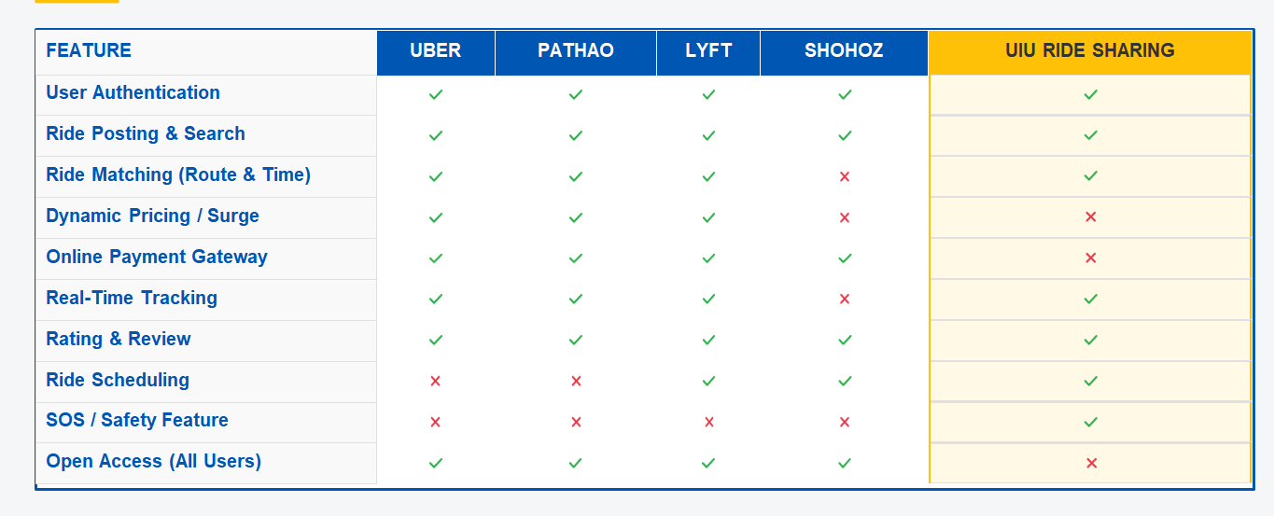
Market Comparison: Campus-Cruise vs. Giants
Feature
Uber / Pathao
UIU Ride Sharing
Target Audience
General Public
Verified UIU Students
EXCLUSIVE
Trust Level
Variable / Public
High (University Verified)
Cost Structure
Dynamic / Surge Pricing
Affordable / Student-Friendly
Safety Focus
General Security
Closed Community Trust
Access Control
Open to All
Restricted (UIU Email)

Slide 11




Driving the Future of UIU Commuting
Cost Reduction
Sustainability
Community
Thank You!
LET'S RIDE TOGETHER

